Slide 1

Introduction
CIS 360 – Prof. C. R. Johnson
University of Wisconsin – Stevens Point

Slide 2
Evolution of security perimeters
Physical
Network
Identity
Notes:
Key Takeaway: The need for a security perimeter has stayed consistent, but its form has evolved over time
We started off with physical perimeters to protect physical assets using walls, cameras, and guards.
CLICK 1
As we network computers together and saw attacks come in, we realized we needed to adapt these concepts to protect computers on a network.
CLICK 2
As we now progress beyond corporate controlled networks to enterprise is that span the Internet, we now need a new type of security perimeter. The common controls we have available are all based on identity and access-- authentication and authorization controls.
Let’s take a deeper look into this evolution

Slide 3
Identity Perimeter – 0 Trust or Bust
Applications
Identity perimeter
Visibility and control across your estate
Identities
Data usage across corporate and SaaS apps
Managed and mobile devices
Reinforced by device & hardware assurances
Devices
Infrastructure
Notes:
Key Takeaway: Establishing an identity security perimeter is critical to getting you visibility in control of a modern enterprise.
We have chosen to represent this as a “new perimeter” rather than “perimeter-less” for two reasons:
The core purpose of a security perimeter still applies well (separation of threats from resources using consistent control set)
It is difficult to develop a strategy to manage something that doesn’t exist

Slide 4
Disrupt Attacker ROI
Rapid detection and response drives down predictability and quantity of return
Defender Return:
Ruin Attacker ROI
Deters opportunistic attacks
Slows or stops determined attacks
Attacker Return: Successful Monetization
Security Return on Investment (SROI)
Attacker Investment: Increase Attack Friction & Cost
Defender Investment:
Security budget
Team time/attention
Prioritizing defense can rapidly raise impact attacker cost & friction
Notes:
Key Takeaway – Defenders should measure success by how much they have raised the cost attacks for attackers
Security Return on Investment (SROI) is difficult to calculate in a precise mathematical way because both components of risk are clouded with imprecision
Impact: Many of the outcomes are unknown and difficult to measure (e.g. which competitive products have benefitted from intelligence stolen from your environment?)
Likelihood: This is driven by uncertainty influenced by adaptive/reactive human attacker decisions (unlike the probability of events like car accidents or diseases which stay relatively constant)
CLICK 1
Defender Investment is composed of
Security budget for purchasing technology and hiring/rewarding people
The time and attention of the team members you have hired
CLICK 2
Defender Return is composed of your ability to
Reduce the attacker's ROI which has the effect of
Discouraging opportunistic attackers who will move on to another target that is easier to attack
Reducing the frequency/success of determined adversaries who are targeting your organization specifically
Reduce the business impact of any attack on your organization
CLICK 3
Attacker ROI is an important factor that defenders must work to influence
Attacker Return is largely out of the influence/control of individual defenders (e.g. black market availability, law enforcement effectiveness, etc.) so we don’t recommend spending a lot of time/attention on this.
Attacker Investment is the best opportunity for a defender to influence success. By adopting a strategy that is focused on defeating the cheapest attack mechanisms, you can force an attacker to invest more money/time/resources into more methods to successfully attack you. This reduces their chances of success, limits or slows the successes they do have, and can deter some attackers from targeting you.

Slide 5




Increasing attack cost User credential theft
Defenses
Attack Options
Attack Cost
Leaked credential detection and forced password reset
Zero Touch:
Public password compromise
$
a. Office 365 ATP Windows Defender SmartScreen
b. Hardware Credential Isolation
Credential Guard
Windows Hello
Low Touch:
Phishing email → a. Fake credential site
b. Script to steal credential
$$
Advanced Host Detections:
Defender ATP + Defender AV
High Touch Operation:
Compromise trusted device(s) via
Spearphishing → malware
Phishing → lateral traversal → malware
$$$
$$
+ Higher risk of detection
Notes:
Key Takeaway: Microsoft has invested into raising cost of attacks for attackers attempting to steal your credentials
Zero Touch - The cheapest and easiest way for an attacker to get your users’ credentials it to download stolen credentials from a public password compromise, frequently called a “breach replay” attack
CLICK 1
BLUE/DEFENSE
Microsoft monitors sites where attackers post these credentials and reports on these leaked credentials in Azure Active Directory so you can have these users reset the password they shared between sites. (Note that the password hashes have to be synched to Azure AD for this feature to work)
RED/ATTACK
Low Touch - This drives attackers into more expensive attacksl the next cheapest is a low touch attack using a phishing email that either
a. Directs the user to enter their credentials into a fake logon website
b. Uses a script or malware to steal credentials from the local machine (non-persistent)
CLICK 2
BLUE/DEFENSE
a. Office 365 ATP protects against malicious links in phishing email and Windows Defender Smartscreen is integrated into Microsoft browsers to protect against malicious websites
b. Windows 10 includes TPM hardware protections to prevent theft of both legacy enterprise credentials (Kerberos and NTLM protected by Credential Guard) as well as modern biometric credentials (Windows Hello)
RED/ATTACK
High Touch - This drives attackers to a high touch operation that requires them to compromise a trusted device in order to steal your credentials. Attackers can either
Research and target the right person with spearphishing to install malware on their computer
Enter the environment through phishing any user and then perform lateral traversal to install malware on the targeted user’s computer and steal the credential
CLICK 3
BLUE/DEFENSE
By using advanced host mitigation and detections built into Windows 10 that, you increase the chances the attack will fail or be detected/cleaned, forcing the attacker to start the operation over again, all of which further adds to the attacker cost.

Slide 6

Increasing attack cost Abuse credentials to access cloud assets
Defenses
Attack Options
Attack Cost
Multi-factor authentication
AAD and AD / Partners
Zero Touch:
Access Cloud assets from any device
$
Link
Azure AD Identity Protection Risky Sign-ins (Suspicious or anonymous IP addresses, Impossible travel, unfamiliar locations, anomalous user behavior (UEBA), etc.)
Conditional Access based on device health device, trusted domain membership and/or IP address
Low Touch:
Compromise user’s mobile device
Phishing → fake MFA site
Link
$$
Link
Anomalous user behavior (UEBA)
Azure Advanced Threat Protection Advanced Host Detections:
Defender ATP + Defender AV
High Touch Operation:
Compromise trusted device(s) via
Spearphishing → malware
Phishing → lateral traversal → malware
$$$
Link
$$
Link
Link
+ Higher risk of detection
Notes:
Key Takeaway: Microsoft has invested into raising cost of attacks for attackers attempting to abuse stolen credentials to access your cloud assets
This sequence assumes the adversary already has possession of a a valid credential in your Azure Active Directory
The cheapest and easiest way to use it to access cloud assets is to simply log on with the credential
CLICK 1
BLUE/DEFENSE
Microsoft (and several partners) offer multi-factor authentication that sends single use codes to a mobile phone to validate possession of the phone
RED/ATTACK
Low Touch - This drives attackers into more expensive attacks that requires them to compromise the user’s mobile device or set up a fake website for the user
(note that this will not work for a user that is running a trusted application for the MFA authentication such as the Azure MFA application)
CLICK 2
BLUE/DEFENSE
Azure AD Identity protections includes the ability to detect risky sign ins that reflect many risk factors. (Note that on-premises AD accounts need to have passwords synchronized to Azure AD in order to take advantage of this capability)
Azure AD Conditional access allows you to set policy based on the authentication risk level and the security health of the device being used for authentication, raising the amount of work (and cost) to mimic the valid user behavior so they can evade these defenses.
RED/ATTACK
High Touch - This drives attackers to a high touch operation that requires them to compromise a trusted device in order to steal your credentials. The attacker would need to either
Research and target the right person with spearphishing to install malware on their computer
Enter the environment through phishing any user and then perform lateral traversal to install malware on the targeted user’s computer and steal the credential
CLICK 3
BLUE/DEFENSE
By using advanced host mitigation and detections built into Windows 10 that, you increase the chances the attack will fail or be detected/cleaned, forcing the attacker to start the operation over again, all of which further adds to the attacker cost.
Additionally, if the account being used for lateral traversal is an on-premises Active Directory account, this can be detected using Azure Advanced Threat Protection (or Advanced Threat Analytics capability that builds a profile for each user’s normal behavior and reports anomalies.

Slide 7
Increasing attack cost Abuse credentials to access on-premises assets
Defenses
Attack Options
Attack Cost
Multi-factor authentication
Partner(s)
Anomaly Detection with SIEM
Partner(s)
Zero Touch:
Access Extranet assets or VPN from any device
$
Anomalous user behavior (UEBA)
Azure Advanced Threat Protection Advanced Host Detections:
Defender ATP + Defender AV
High Touch Operation:
Compromise trusted device(s) via
Spearphishing → malware
Phishing → lateral traversal → malware
$$$
$$
Link
Link
Link
$$$$
High Touch: (Partner/SupplierVariation)
Relay attack by compromising trusted business partners/suppliers
$$
+ Higher risk of detection
Notes:
Key Takeaway: Microsoft has invested into raising cost of attacks for attackers attempting to steal credentials to access your on-premises assets
Assuming the adversary has stolen a valid Active Directory user credential, the cheapest and easiest way to use it to access on premises assets is to simply log on with the credential directly to a published application (Outlook Web App (OWA)or other corporate application in the extranet) or use it to VPN into your corporate network.
CLICK 1
BLUE/DEFENSE
Several Microsoft partners offer solutions to require multi-factor authentication for VPNs and published websites
RED/ATTACK
High Touch - This drives attackers to a high touch operation that requires them to compromise a trusted device in order to steal your credentials. Attacker would need to either
Research and target the right person with spearphishing to install malware on their computer
Enter the environment through phishing any user and then perform lateral traversal to install malware on the targeted user’s computer and steal the credential
CLICK 2
BLUE/DEFENSE
You can further increase the attacker’s cost by using advanced host detections built into Windows 10 that increase the chances the attacker will be detected and have to start the operation over before achieving their objective.
Additionally, the attack can be detected using Azure Advanced Threat Protection (or Advanced Threat Analytics) capability that builds a profile for each user’s normal behavior and reports anomalies.
CLICK 3
Additionally, we see attackers use 3rd party suppliers and partners to get access to these on premises resources. They compromise the 3rd party and take advantage of the access path that the organization has opened for these suppliers to do business with the target organization.
Additional Information
Note that accessing an asset shared via Azure Application Proxy or similar capability that leverages Azure AD authentication would be categorized as a cloud scenario

Slide 8
Critical Infrastructures
Energy (electrical, nuclear, gas and oil, dams)
Transportation (air, road, rail, port, waterways)
Public Health Systems / Emergency Services
Information and Telecommunications
Defense Industry
Banking and Finance
Postal and Shipping
Agriculture / Food / Water
Chemical

Slide 9
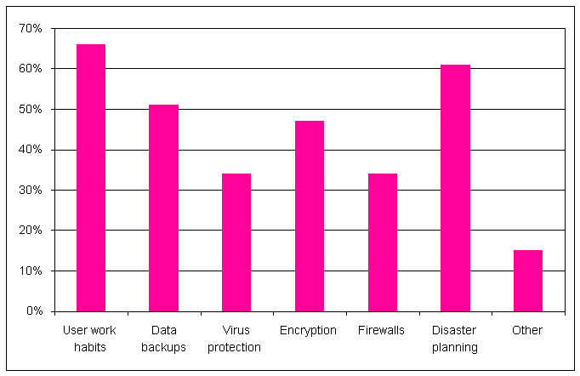
In your opinion, what are the computer security issues that your organization needs to address?

Slide 10
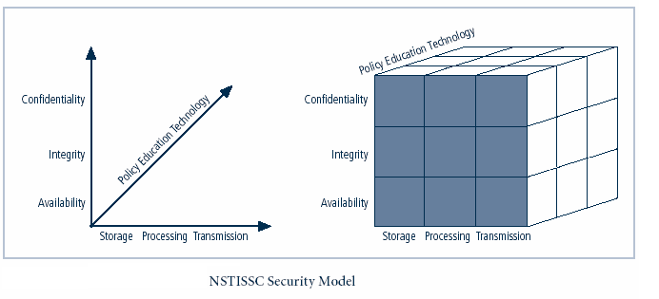
McCumber Cube
Notes:
This graphic informs the fundamental approach of the chapter and can be used to illustrate the intersection of information states (x-axis), key objectives of C.I.A. (y-axis) and the three primary means to implement (policy, education and technology).

Slide 11
Introduction
To secure its network environment, organization must establish a functional and well-designed information security program
Information security program begins with creation or review of organization’s information security policies, standards, and practices
Selection or creation of information security architecture and development and use of detailed information security blueprint will create plan for future success
Without policy, blueprints, and planning, organization’s security needs will not be met
Notes:
Introduction
The creation of an information security program begins with an information security blueprint, and before we can discuss the creation and development of a blueprint, it is important to look at management’s responsibility in shaping policy.
It is prudent for information security professionals to know the information security polices and how these policies contribute to the overall objectives of the organization.

Slide 12
Information Security Policy, Standards, and Practices
Management must consider policies as basis for all information security efforts
Policies direct how issues should be addressed and technologies used
Security policies are the least expensive control to execute but the most difficult to implement
Shaping policy is difficult because policy must:
Never conflict with laws
Stand up in court, if challenged
Be properly administered through dissemination and documented acceptance
Notes:
Information Security Policy, Standards and Practices
Management from all communities of interest must consider policies as the basis for all information security planning, design, and deployment.
In general, policies direct how issues should be addressed and technologies used, not cover the specifics on the proper operation of equipment or software.
Quality security programs begin and end with policy.
As information security is primarily a management rather than technical problem, policy guides personnel to function in a manner that will add to the security of its information assets.
Security policies are the least expensive control to execute, but the most difficult to implement.
Shaping policy is difficult because it must:
1) Never conflict with laws.
2) Stand up in court, if challenged.
3) Be properly administered, including thorough dissemination, and documentation from personnel showing they have read the policies.

Slide 13
Information Security Policy, Standards, and Practices (continued)
For a policy to be considered effective and legally enforceable:
Dissemination (distribution): organization must be able to demonstrate that relevant policy has been made readily available for review by all employees
Review (reading): organization must be able to demonstrate that it disseminated document in intelligible form, including versions for illiterate, non-English reading, and reading-impaired employees

Slide 14
Information Security Policy, Standards and Practices (continued)
Comprehension (understanding): organization must be able to demonstrate that employees understand requirements and content of policy
Compliance (agreement): organization must be able to demonstrate that employees agree to comply with policy through act or affirmation OR ELSE
Uniform enforcement: organization must be able to demonstrate policy has been uniformly enforced

Slide 15
Definitions
Policy is set of guidelines or instructions an organization’s senior management implements to regulate activities of members of organization who make decisions, take actions, and perform other duties
Policies are organizational laws
Standards, on the other hand, are more detailed statements of what must be done to comply with policy
Practices, procedures, and guidelines effectively explain how to comply with policy
Notes:
A policy is
A plan or course of action, as of a government, political party, or business, intended to influence and determine decisions, actions, and other matters
Policies are organizational laws
Policies must contain information on what is right, and what is not; what the penalties are for violating policy, and what the appeal process is
Standards, on the other hand, are more detailed statements of what must be done to comply with policy
Practices, procedures and guidelines effectively explain how to comply with policy
For a policy to be effective it must be properly disseminated, read, understood and agreed to by all members of the organization.

Slide 16
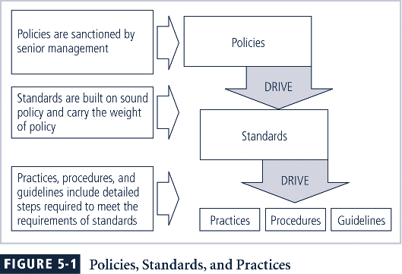
Policies, Standards, & Practices

Slide 17
Enterprise Information Security Policy (EISP)
EISP is also known as general security policy, IT security policy, or information security policy
Sets strategic direction, scope, and tone for all security efforts within the organization
Executive-level document, usually drafted by or with CIO of the organization and usually 2 to 10 pages long
Notes:
Security Program Policy
A security program policy (SPP) is also known as a general security policy, IT security policy, or information security policy. This policy sets the strategic direction, scope, and tone for all security efforts within the organization.
The SPP is an executive-level document, usually drafted by or with, the CIO of the organization and is usually 2 to 10 pages long.
When the SPP has been developed, the CISO begins forming the security team and initiates the SecSDLC process.

Slide 18
Issue-Specific Security Policy (ISSP)
Guidelines needed to use various technologies and processes properly
The ISSP:
Addresses specific areas of technology
Requires frequent updates
Contains issue statement on the organization’s position on an issue
Three approaches:
Create several independent ISSP documents
Create a single comprehensive ISSP document
Create a modular ISSP document
Notes:
Issue-Specific Security Policy (ISSP)
As the organization executes various technologies and processes to support routine operations, certain guidelines are needed to instruct employees to use these technologies and processes properly.
In general, the ISSP
1) addresses specific areas of technology
2) requires frequent updates, and
3) contains an issue statement on the organization’s position on an issue.
There are a number of approaches toward creating and managing ISSPs within an organization.
Three of the most common are:
Create a number of independent ISSP documents, each tailored to a specific issue
Create a single comprehensive ISSP document attempting to cover all issues
Create a modular ISSP document that unifies policy creation and administration, while maintaining each specific issue’s requirements

Slide 19
Systems-Specific Policy (SysSP)
SysSPs frequently codified as standards and procedures used when configuring or maintaining systems
SysSPs fall into two groups:
Managerial guidance SysSPs: created by management to guide implementation and configuration of technology as well as to regulate behavior of people in the organization
Technical specifications SysSPs: technical policy or set of configurations to implement managerial policy
Notes:
Systems-Specific Policy (SysSP)
While issue-specific policies are formalized as written documents, distributed to users, and agreed to in writing, SysSPs are frequently codified as standards and procedures used when configuring or maintaining systems.
Systems-specific policies fall into two groups:
Managerial Guidance SysSPs - created by management to guide implementation and configuration of technology as well as to regulate behavior of people in the organization
Technical Specifications SysSPs –technical policy or set of configurations to implement managerial policy

Slide 20
Systems-Specific Policy (SysSP) (continued)
Technical SysSPs are further divided into:
Access control lists (ACLs) consist of access control lists, matrices, and capability tables governing rights and privileges of a particular user to a particular system
Configuration rule policies comprise specific configuration codes entered into security systems to guide execution of the system
Notes:
Technical SysSPs fall into two groups:
1) Access control lists (ACLs) consists of the access control lists, matrices, and capability tables governing the rights and privileges of a particular user to a particular system.
2) Configuration Rules comprise the specific configuration codes entered into security systems to guide the execution of the system

Slide 21
Policy Management
Policies are living documents that must be managed and are constantly changing
Special considerations should be made for organizations undergoing mergers, takeovers, and partnerships
To remain viable, security policies must have:
An individual responsible for reviews
A schedule of reviews
A specific policy issuance and revision date
Notes:
Policy Management
Policies are living documents that must be managed and nurtured, and are constantly changing and growing. These documents must be properly disseminated and managed.
Special considerations should be made for organizations undergoing mergers, takeovers and partnerships.
In order to remain viable, these policies must have:
an individual responsible for reviews,
a schedule of reviews,
a method for making recommendations for reviews, and
an indication of policy and revision date.

Slide 22
Frameworks and Industry Standards
Security blueprint is basis for design, selection, and implementation of all security program elements including policy implementation, ongoing policy management, risk management programs, education and training programs, technological controls, and maintenance of security program
Notes:
Frameworks and Industry Standards
With general idea of vulnerabilities in IT systems, security team develops security blueprint, which is used to implement security program
Security blueprint is basis for design, selection, implementation of all security program elements including policy implementation, ongoing policy management, risk management programs, education and training programs, technological controls, and maintenance of security program

Slide 23
Frameworks and Industry Standards (continued)
Security framework is outline of overall information security strategy and roadmap for planned changes to the organization’s information security environment
Number of published information security frameworks, including ones from government sources
Because each information security environment is unique, security team may need to modify or adapt pieces from several frameworks
Notes:
Frameworks and Industry Standards (continued)
Security framework is outline of overall information security strategy and roadmap for planned changes to the organization’s information security environment
Number of published information security frameworks, including ones from government sources
Because each information security environment is unique, security team may need to modify or adapt pieces from several frameworks

Slide 24
Benchmarking and Best Practices
Benchmarking and best practices are reliable methods used by some organizations to assess security practices
Possible to gain information by benchmarking and using best practices and thus work backwards to effective design
Federal Agency Security Practices Site (fasp.nist.gov) designed to provide best practices for public agencies and is adapted easily to private organizations
Notes:
Baselining and Best Business Practices
Baselining and best practices are solid methods for collecting security practices, but can have the drawback of providing less detail for the design and implementation of all the practices needed by an organization, than would a complete methodology.
However, it is possible to gain information by baselining and using best practices, to piece together the desired outcome of the security process, and thus work backwards to an effective design.
The Federal Agency Security Practices Site (fasp.nist.gov) is designed to provide best practices for public agencies, but can be adapted easily to private institutions.
The documents found in this site include specific examples of key policies and planning documents, implementation strategies for key technologies, and outlines of hiring documents for key security personnel.

Slide 25
The Golden Rules Building an Effective Enterprise Information Security Program
Develop an enterprise-wide information security strategy and game plan
Get corporate “buy in” for the enterprise information security program—effective programs start at the top
Build information security into the infrastructure of the enterprise
Establish level of “due diligence” for information security
Focus initially on mission/business case impacts—bring in threat information only when specific and credible

Slide 26
The Golden Rules Building an Effective Enterprise Information Security Program
Create a balanced information security program with management, operational, and technical security controls
Employ a solid foundation of security controls first, then build on that foundation guided by an assessment of risk
Avoid complicated and expensive risk assessments that rely on flawed assumptions or unverifiable data
Harden the target; place multiple barriers between the adversary and enterprise information systems
Be a good consumer—beware of vendors trying to sell “single point solutions” for enterprise security problems

Slide 27
The Golden Rules Building an Effective Enterprise Information Security Program
Don’t be overwhelmed with the enormity or complexity of the information security problem—take one step at a time and build on small successes
Don’t tolerate indifference to enterprise information security problems
Manage enterprise risk—don’t try to avoid it!

Slide 28
Balancing Information Security and Access
Impossible to obtain perfect security—it is a process, not an absolute
Security should be considered balance between protection and availability
To achieve balance, level of security must allow reasonable access, yet protect against threats
Notes:
Security And Access Balancing
When considering information security, it is important to realize that it is impossible to obtain perfect security. Security is not an absolute; it is a process not a goal.
Security should be considered a balance between protection and availability.
To achieve balance the level of security must allow reasonable access, yet protect against threats.

Slide 29
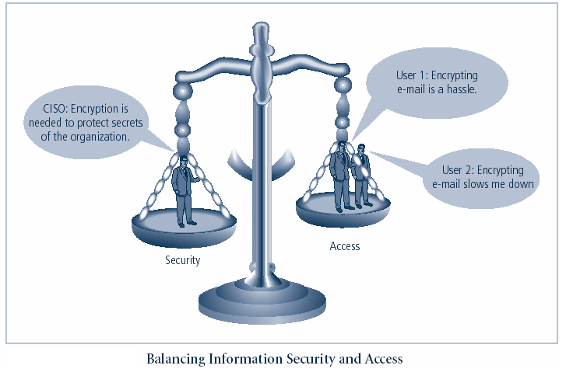
Balancing Security and Access
Notes:
This graphic intends to show that tradeoffs between security and access.

Slide 30
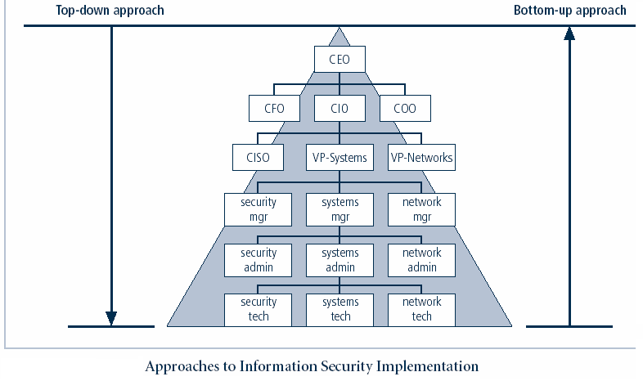
Notes:
Key concept here is the direction of the left and right side arrows to show where planning is sourced and from which direction the pressure for success if driven.

Slide 31
Approaches to Information Security Implementation: Bottom-Up Approach
Grassroots effort: systems administrators attempt to improve security of their systems
Key advantage: technical expertise of individual administrators
Seldom works, as it lacks a number of critical features:
Participant support
Organizational staying power
Notes:
Bottom Up Approach To Security Implementation
Security can begin as a grass-roots effort when systems administrators attempt to improve the security of their systems. This is referred to as the bottom-up approach.
The key advantage of the bottom-up approach is the technical expertise of the individual administrators.
Unfortunately, this approach seldom works, as it lacks a number of critical features, such as participant support and organizational staying power.

Slide 32
Approaches to Information Security Implementation: Top-Down Approach
Initiated by upper management
Issue policy, procedures and processes
Dictate goals and expected outcomes of project
Determine accountability for each required action
The most successful also involve formal development strategy referred to as systems development life cycle
Notes:
Top-down Approach to Security Implementation
An alternative approach, which has a higher probability of success, is called the top-down approach. The project is initiated by upper management who issue policy, procedures and processes, dictate the goals and expected outcomes of the project, and determine who is accountable for each of the required actions.
The top-down approach has strong upper management support, a dedicated champion, dedicated funding, clear planning and the opportunity to influence organizational culture.
The most successful top-down approach also involves a formal development strategy referred to as a systems development life cycle.

Slide 33
Security Professionals and the Organization
Wide range of professionals required to support a diverse information security program
Senior management is key component; also, additional administrative support and technical expertise required to implement details of IS program
Notes:
Security Professionals And The Organization
It takes a wide range of professionals to support a diverse information security program.
To develop and execute specific security policies and procedures, additional administrative support and technical expertise is required

Slide 34
Data Ownership
Data Owner: responsible for the security and use of a particular set of information
Data Custodian: responsible for storage, maintenance, and protection of information
Data Users: end users who work with information to perform their daily jobs supporting the mission of the organization
Notes:
Data Ownership
Now that you understand the responsibilities of both senior management and the security project team, we can define the roles of those who own and safeguard the data.
Data Owner - responsible for the security and use of a particular set of information. Data owners usually determine the level of data classification associated with the data, as well as changes to that classification required by organization change.
Data Custodian - responsible for the storage, maintenance, and protection of the information. The duties of a data custodian often include overseeing data storage and backups, implementing the specific procedures and policies laid out in the security policies and plans, and reporting to the data owner.
Data Users - the end systems users who work with the information to perform their daily jobs supporting the mission of the organization. Everyone in the organization is responsible for the security of data, so data users are included here as individuals with an information security role.

